Slide 1

Digital Logic Design

Slide 2
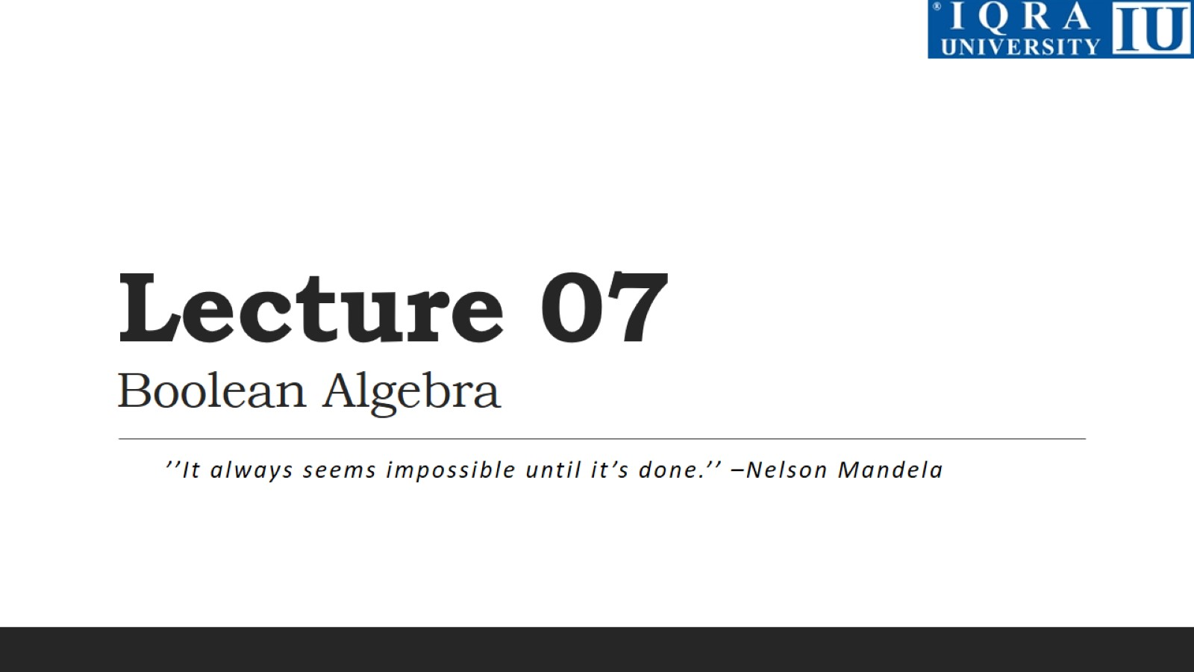
Lecture 07 Boolean Algebra

Slide 3
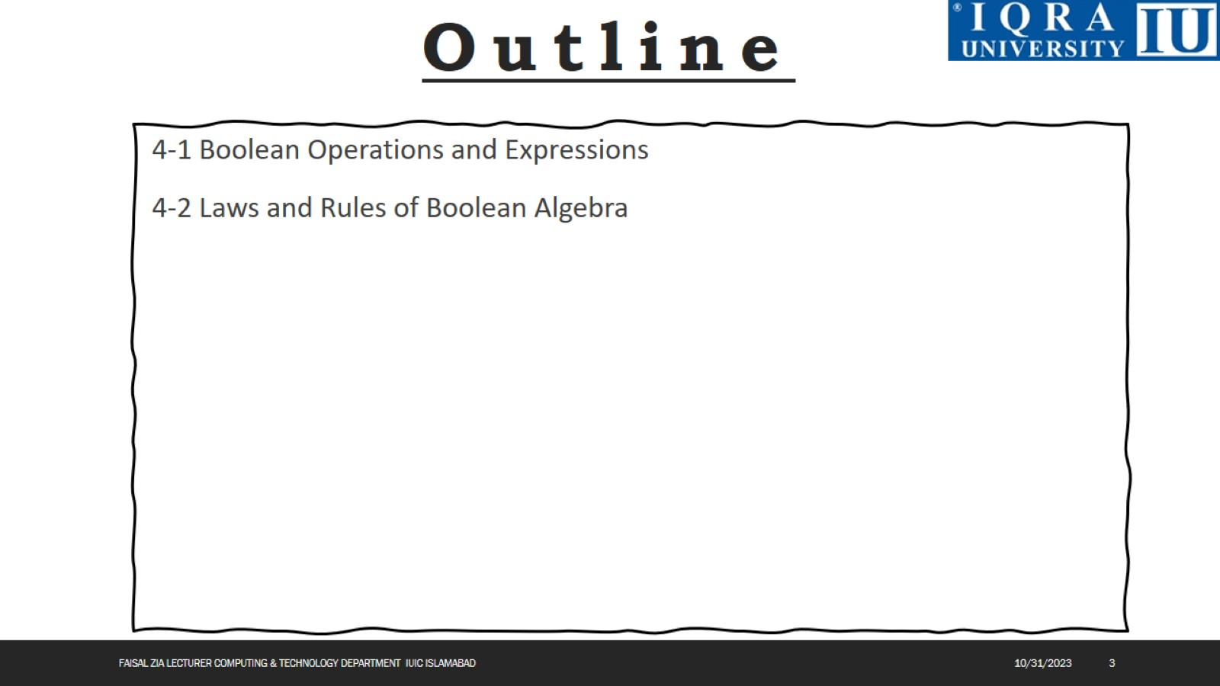

Slide 4
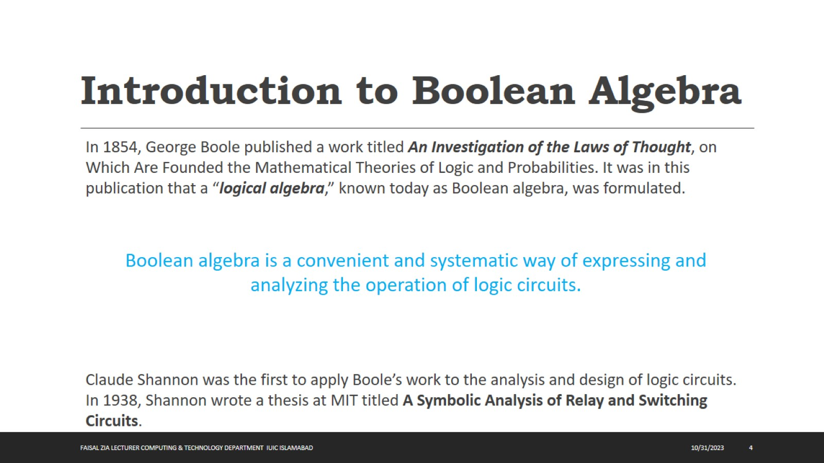
Introduction to Boolean Algebra

Slide 5
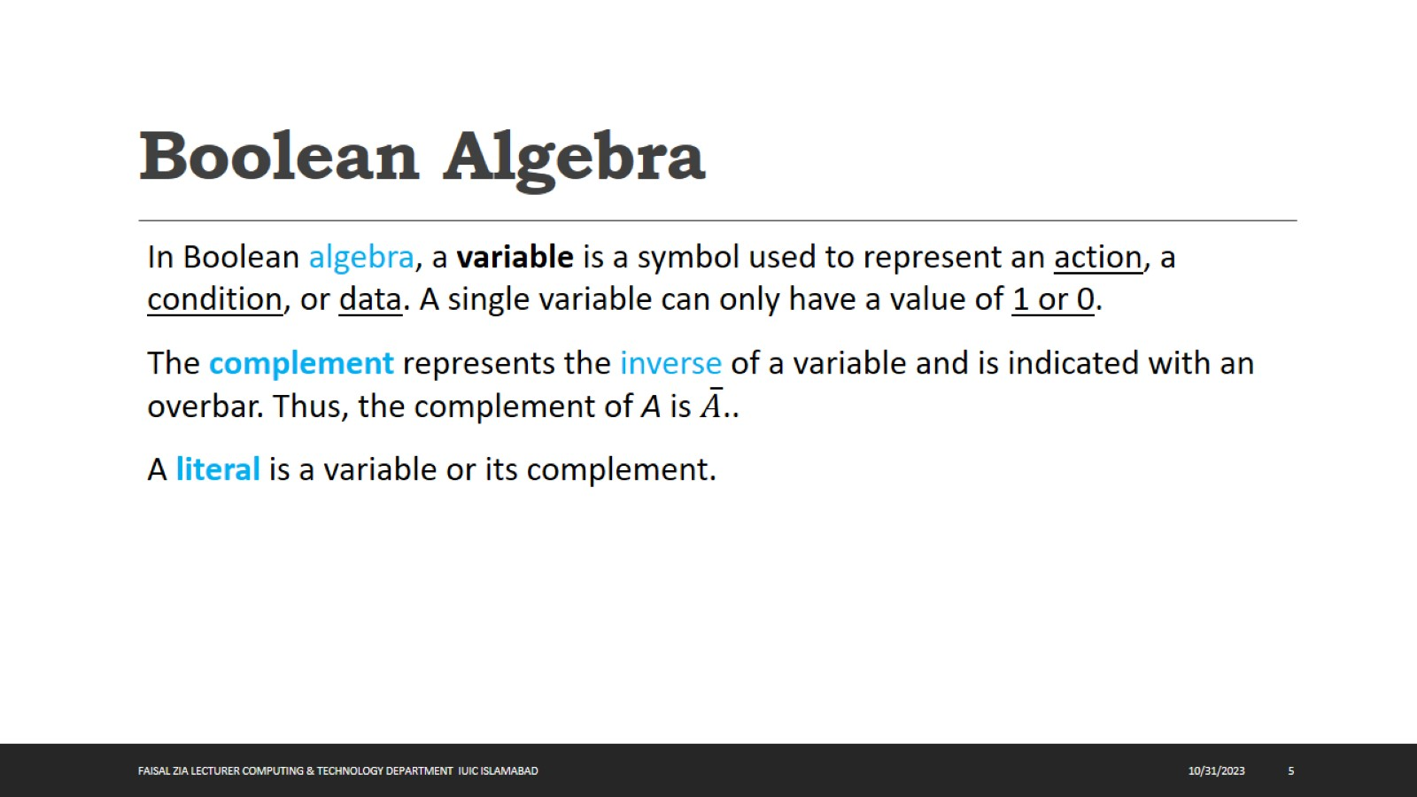
Boolean Algebra

Slide 6
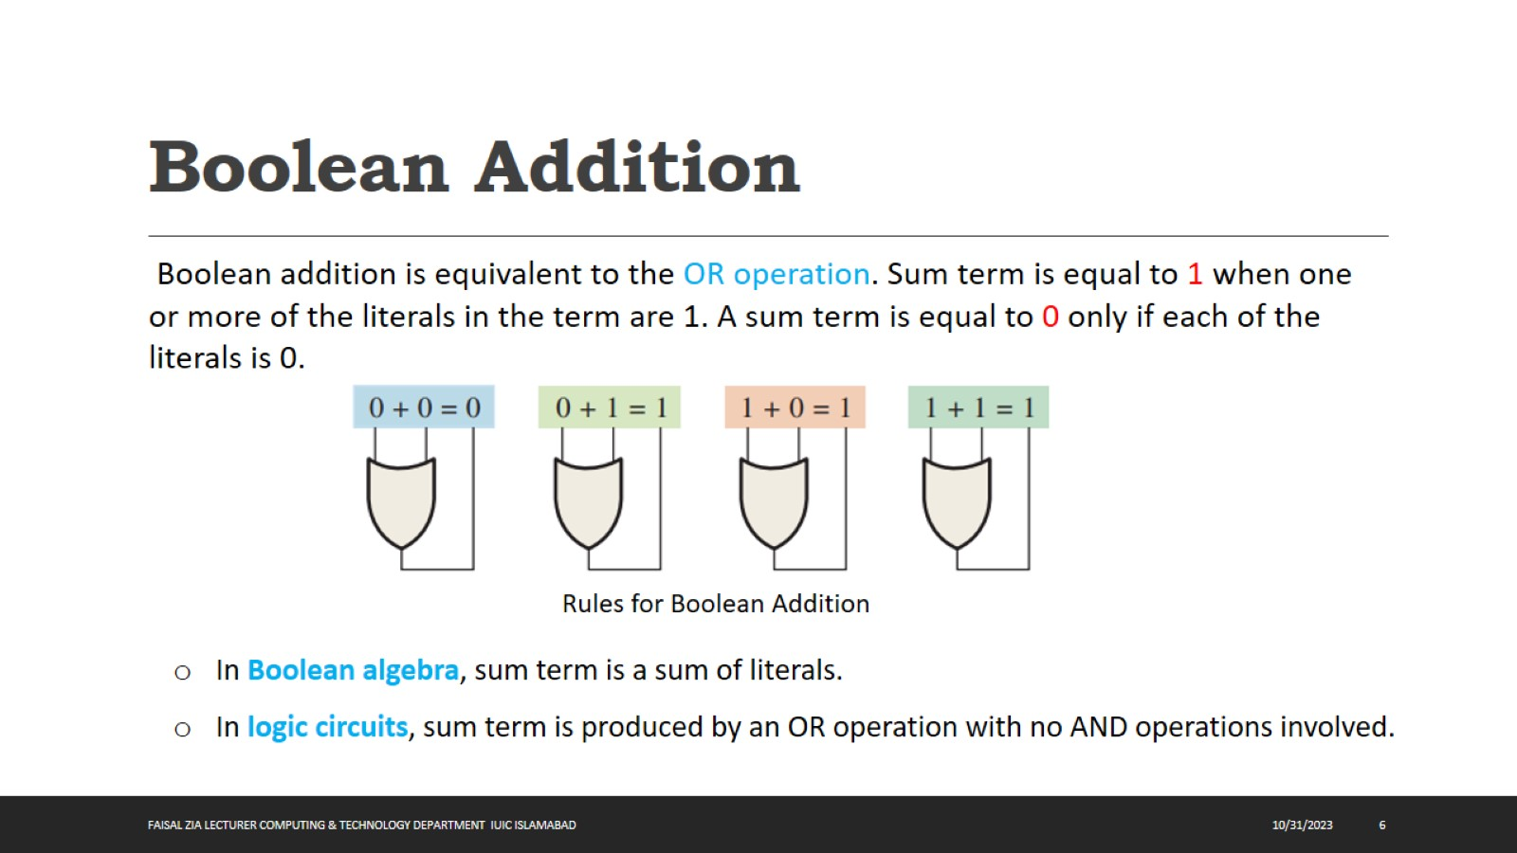
Boolean Addition

Slide 7
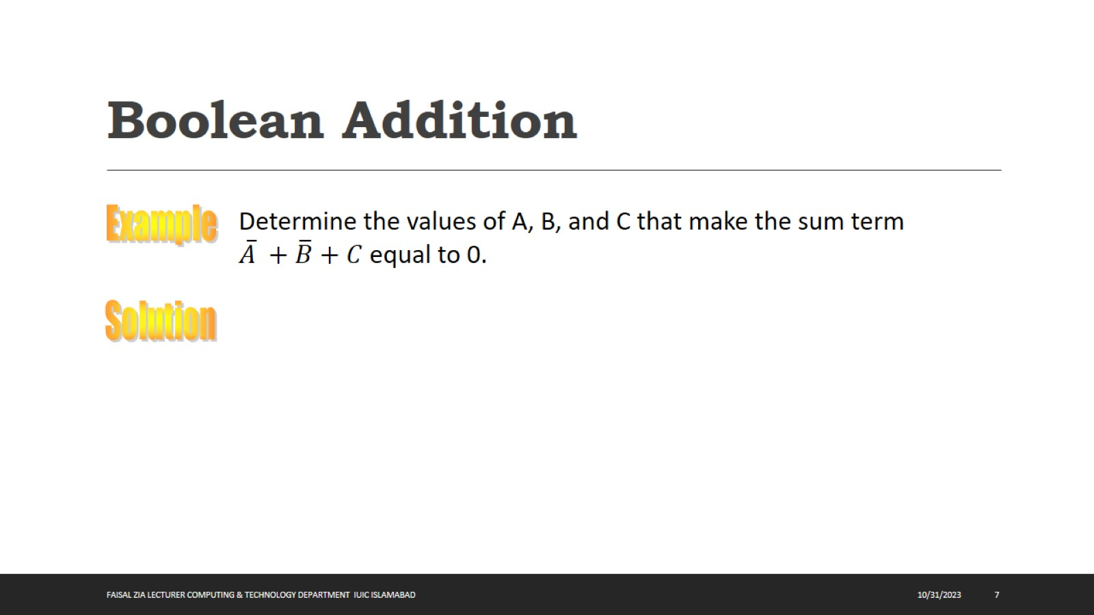
Boolean Addition

Slide 8
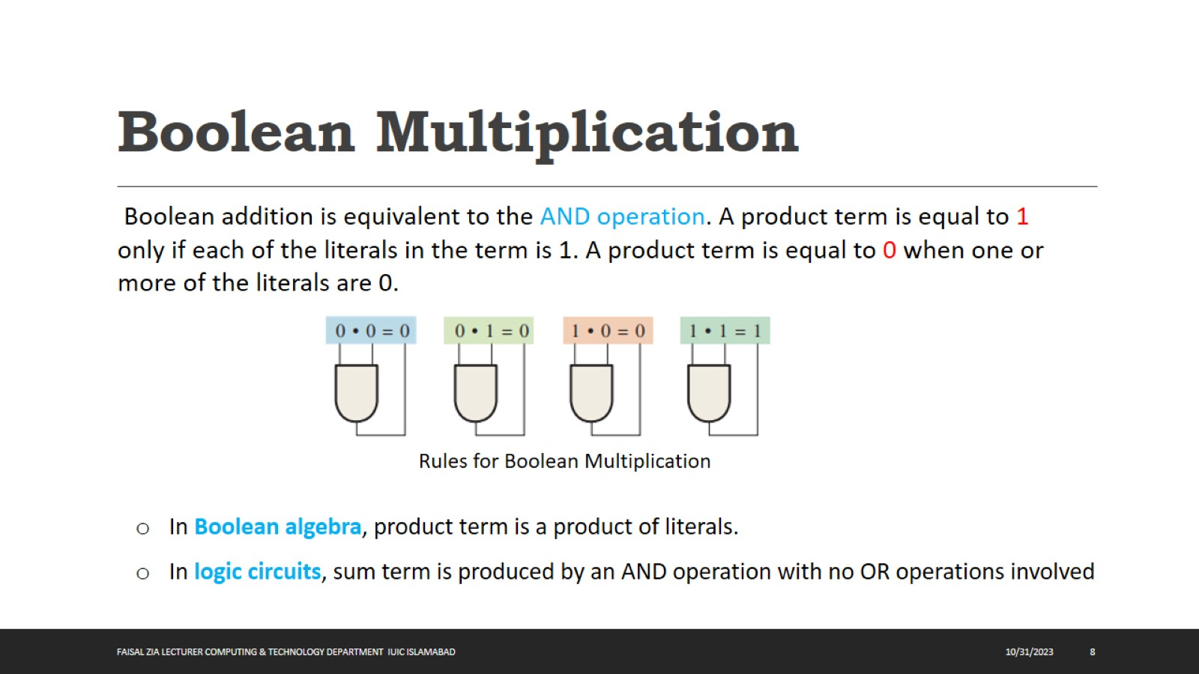
Boolean Multiplication

Slide 9
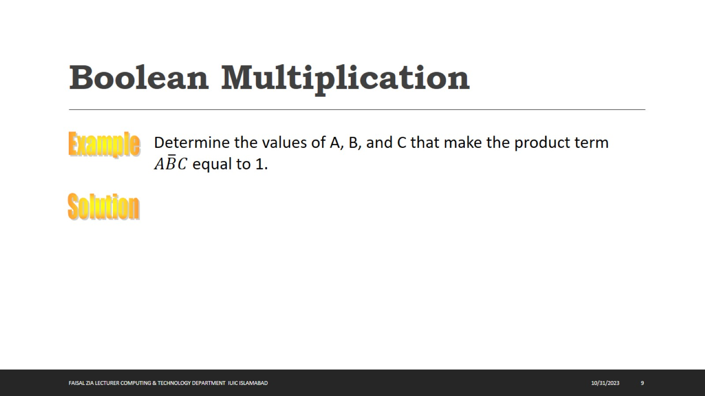
Boolean Multiplication

Slide 10
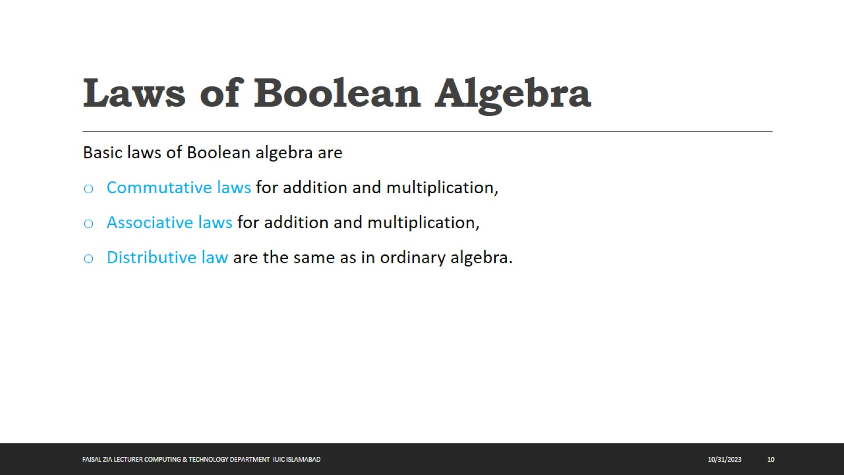
Laws of Boolean Algebra

Slide 11
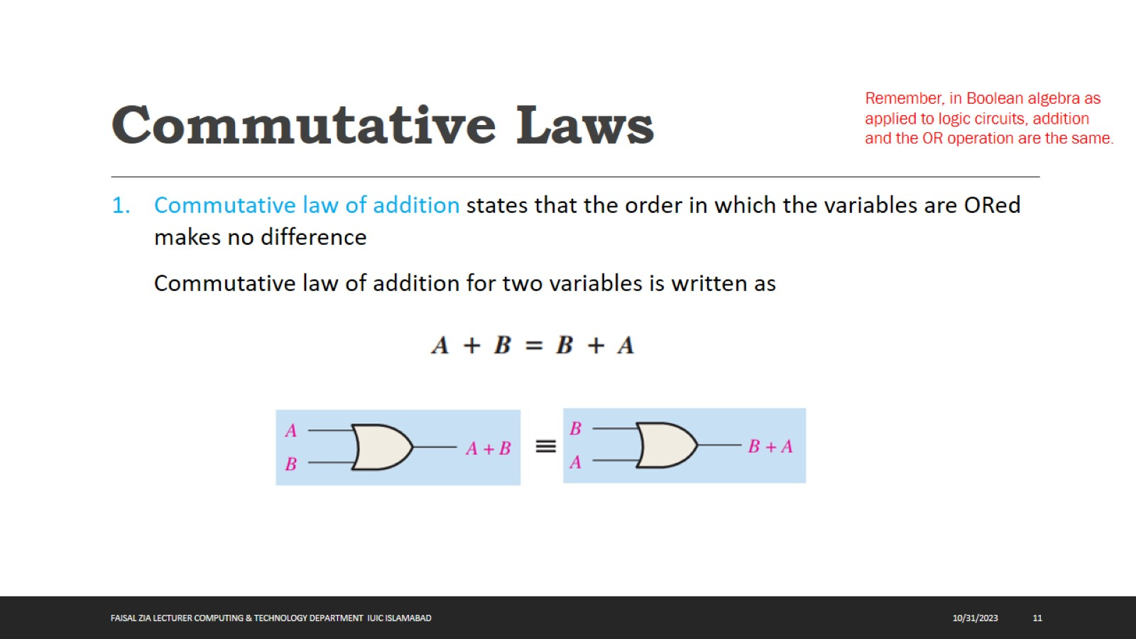
Commutative Laws

Slide 12
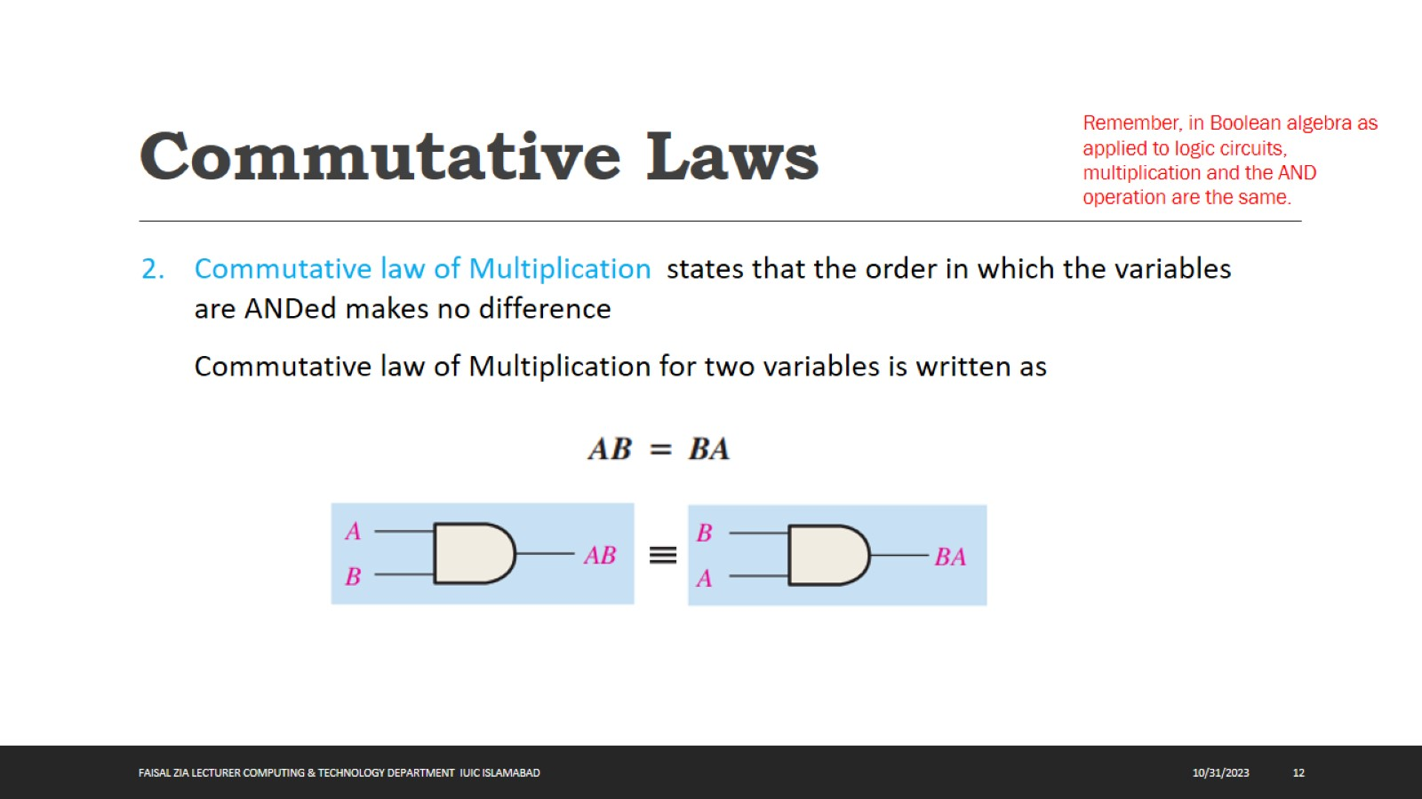
Commutative Laws

Slide 13
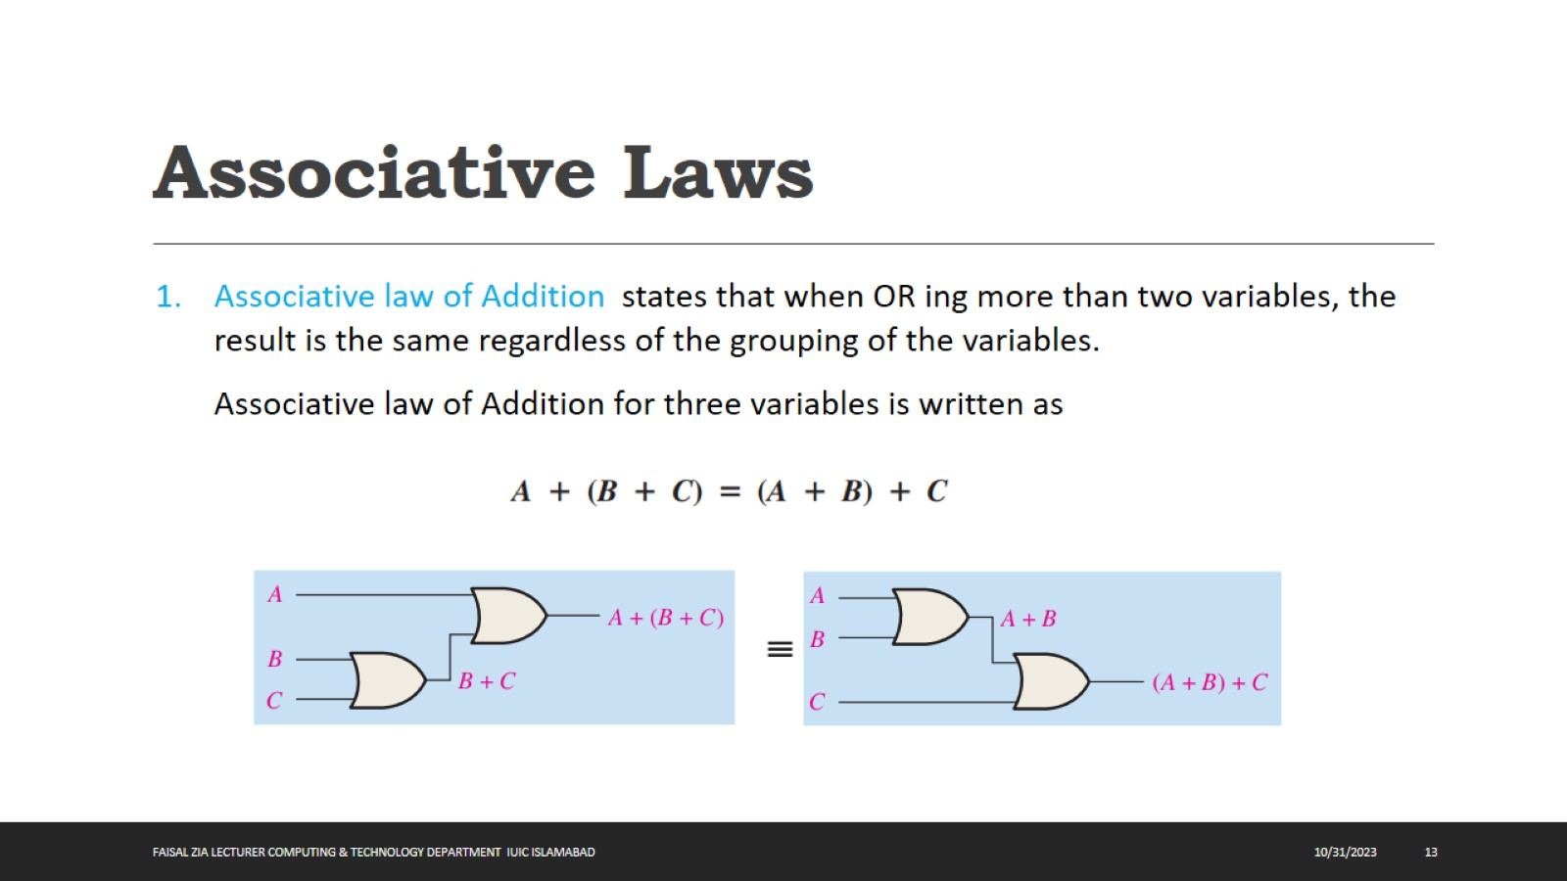
Associative Laws

Slide 14
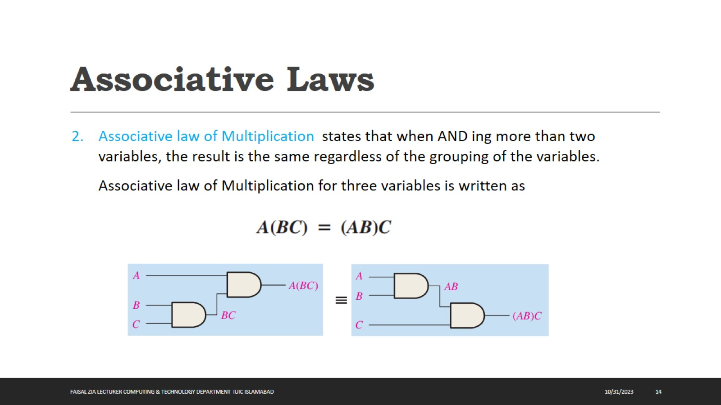
Associative Laws

Slide 15
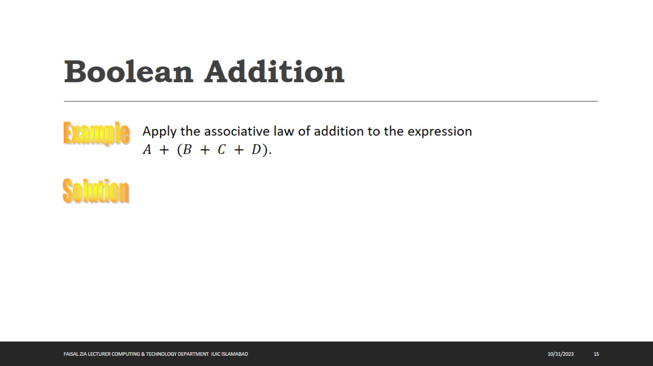
Boolean Addition

Slide 16
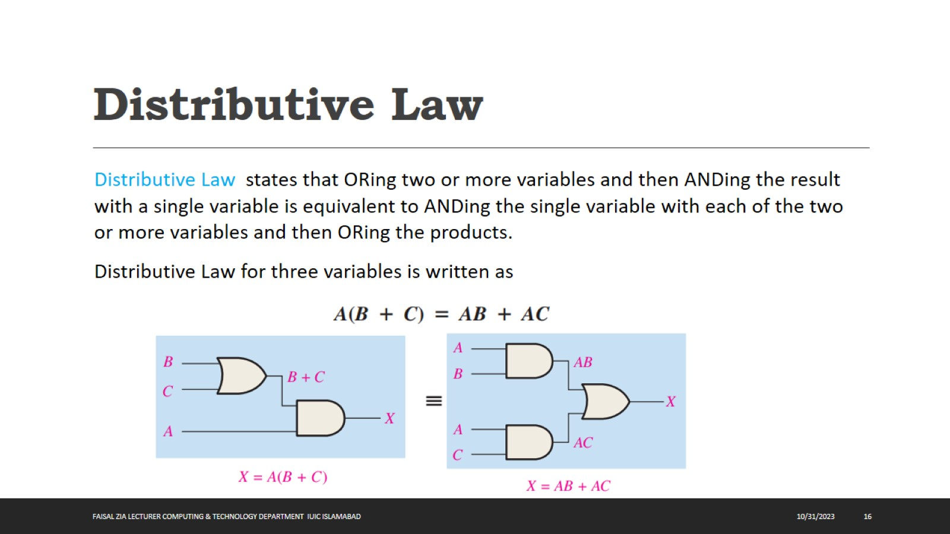
Distributive Law

Slide 17

Boolean Addition

Slide 18
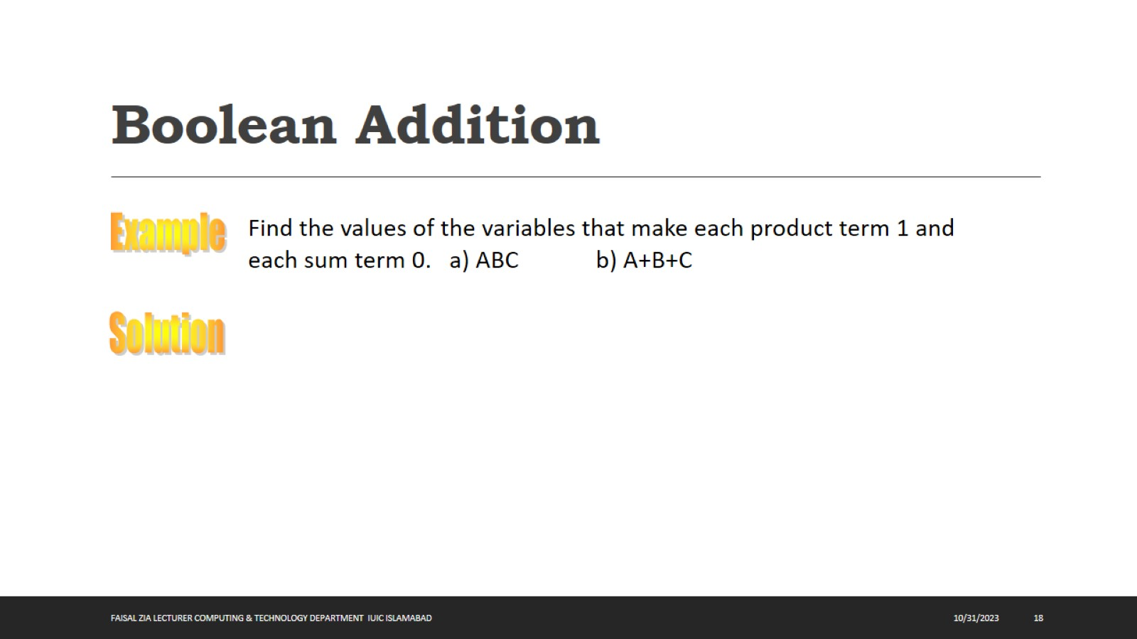
Boolean Addition

Slide 19
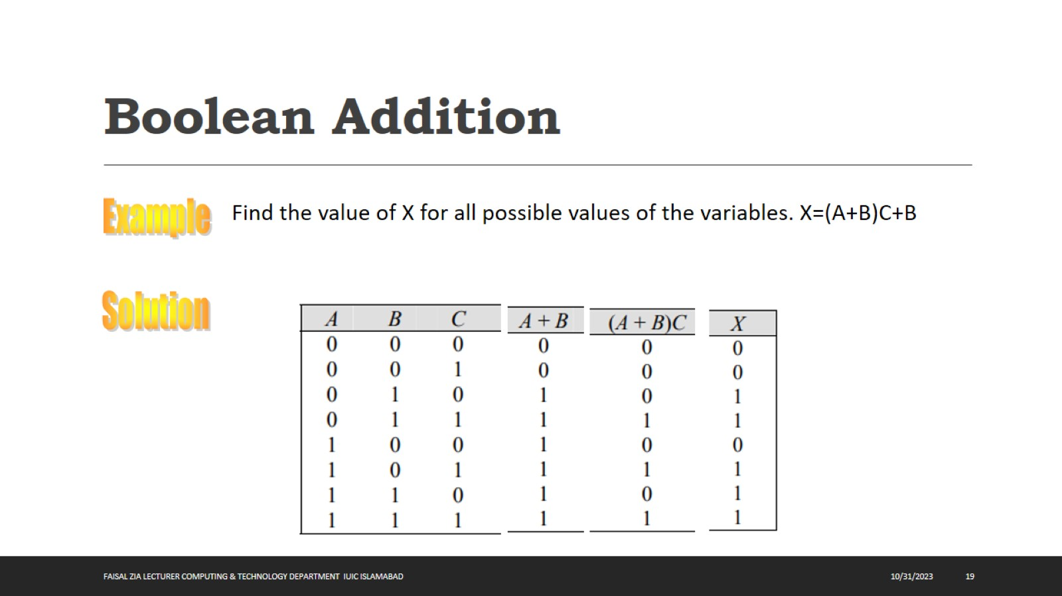
Boolean Addition

Slide 20
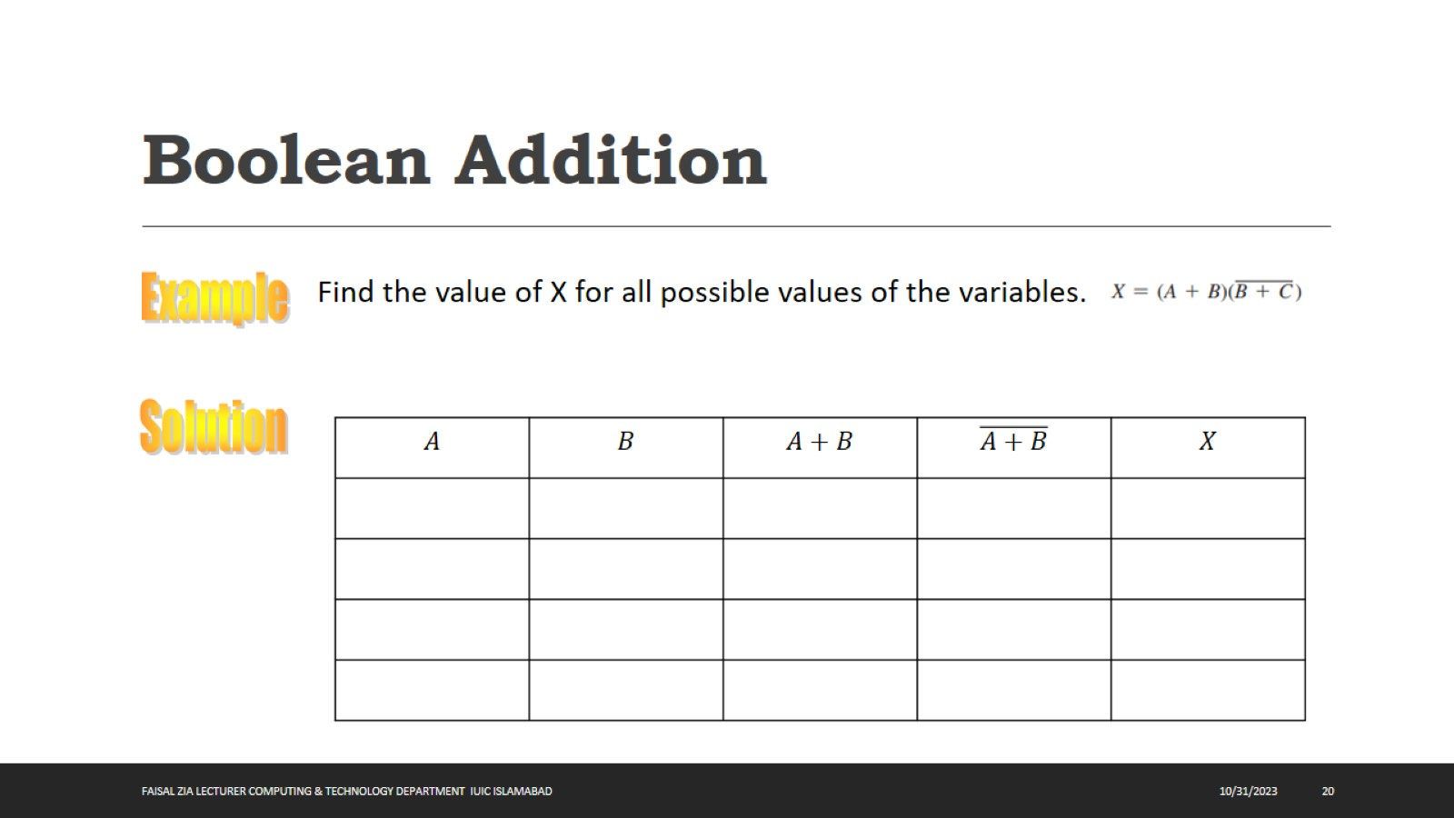
Boolean Addition

Slide 21
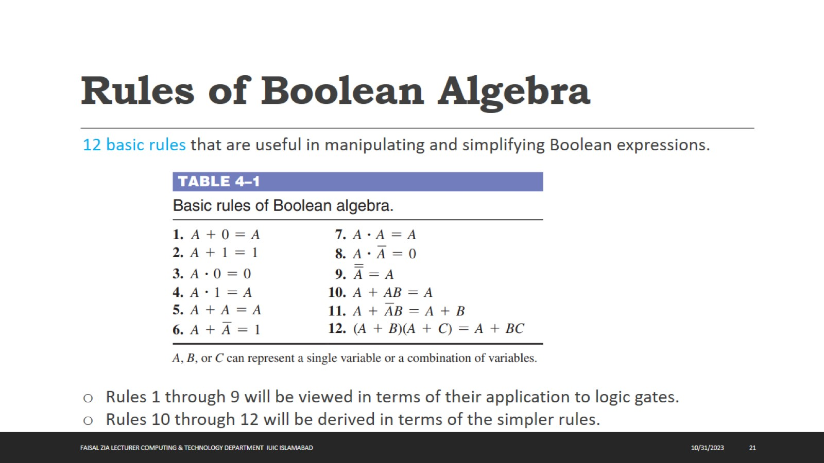
Rules of Boolean Algebra

Slide 22
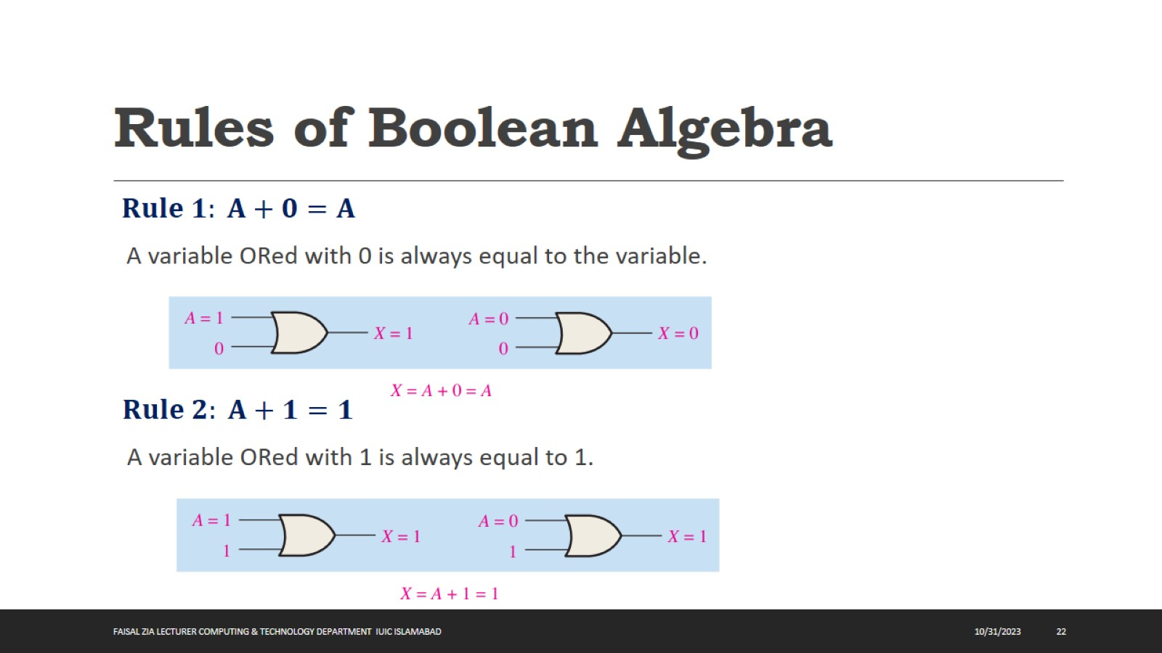
Rules of Boolean Algebra

Slide 23
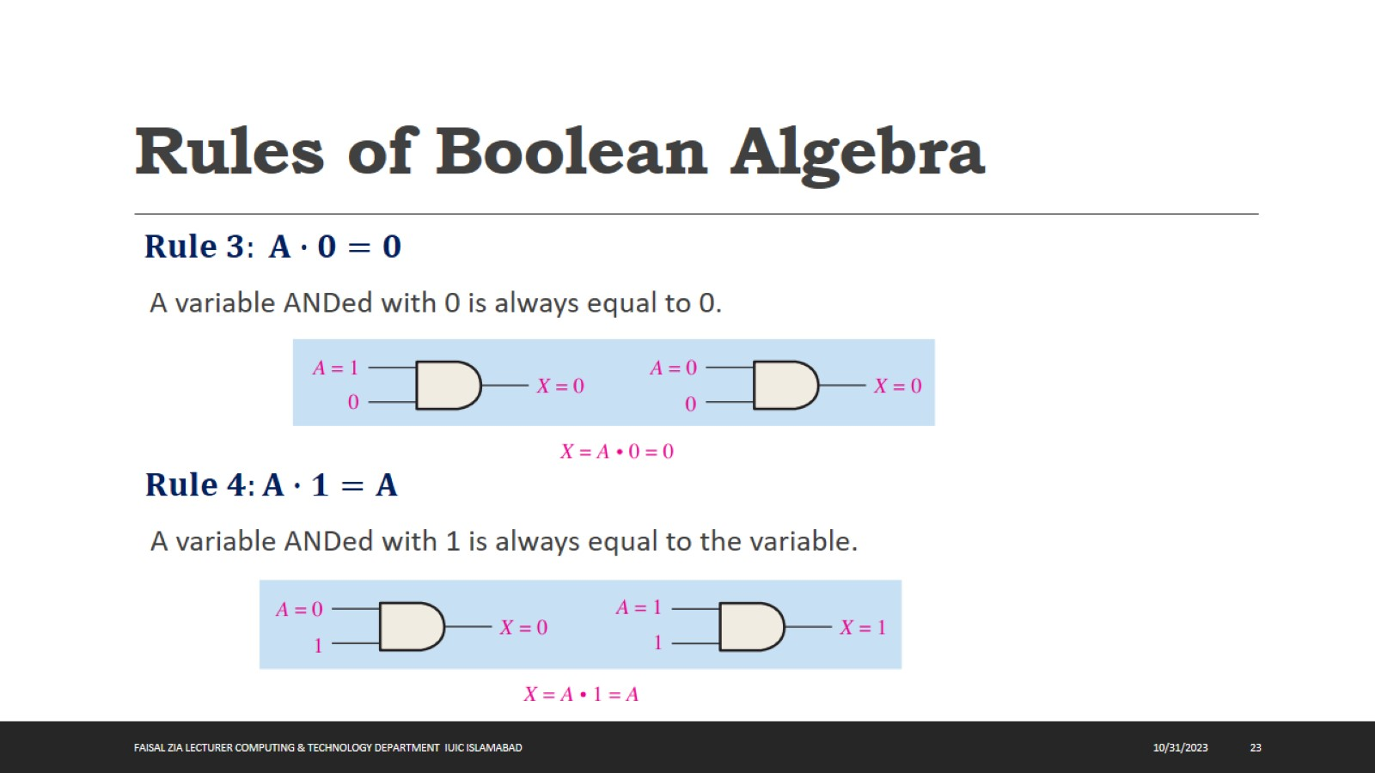
Rules of Boolean Algebra

Slide 24
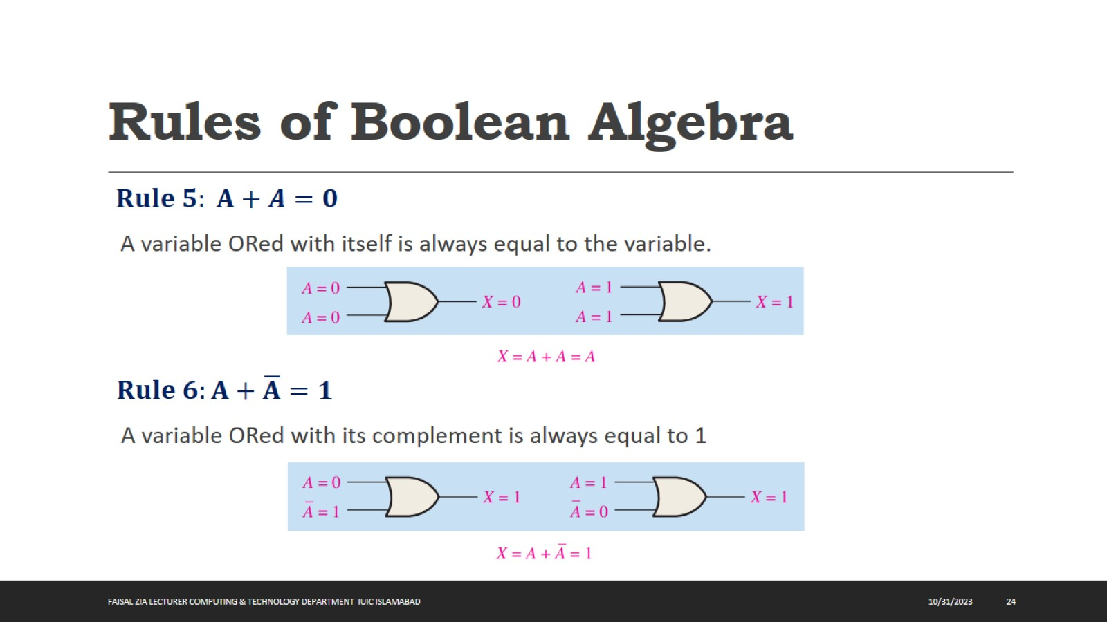
Rules of Boolean Algebra

Slide 25
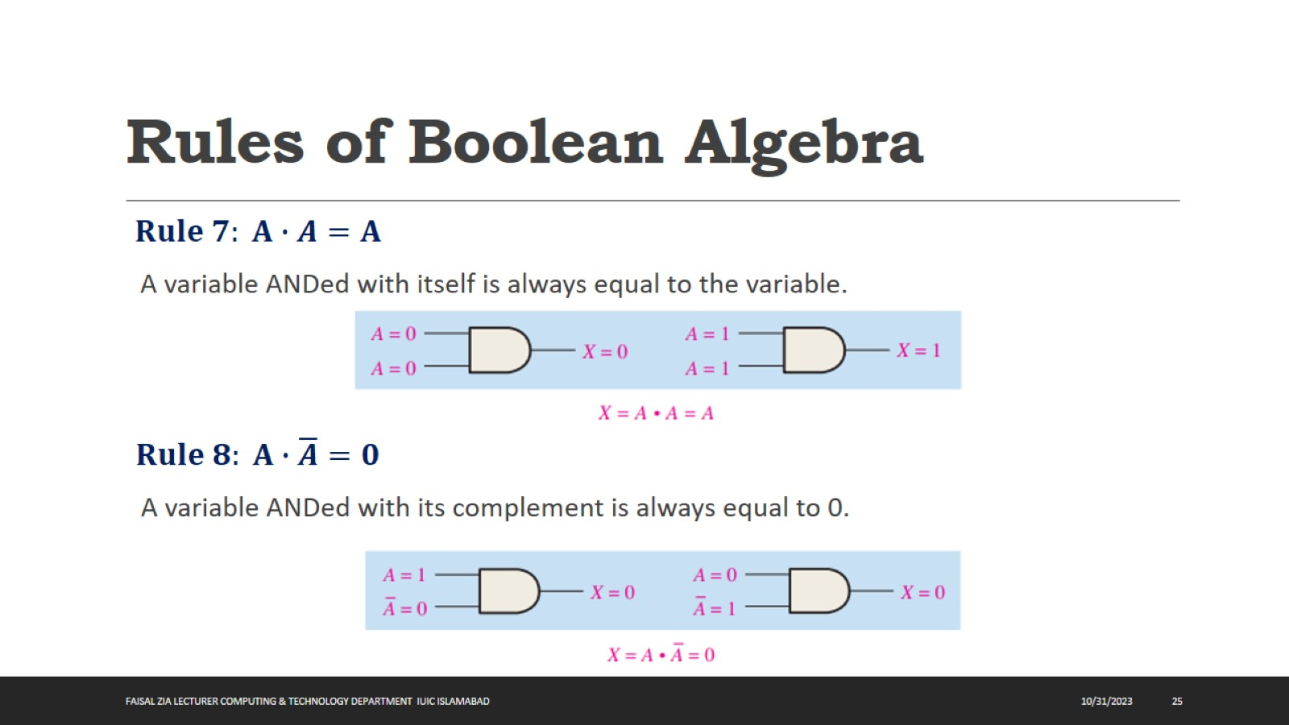
Rules of Boolean Algebra

Slide 26
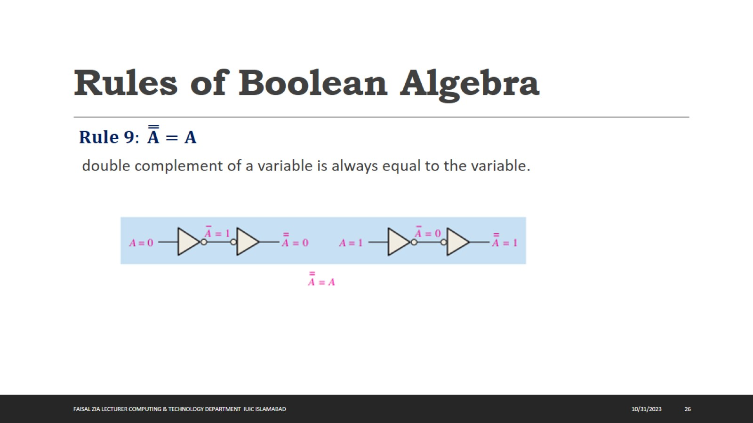
Rules of Boolean Algebra

Slide 27
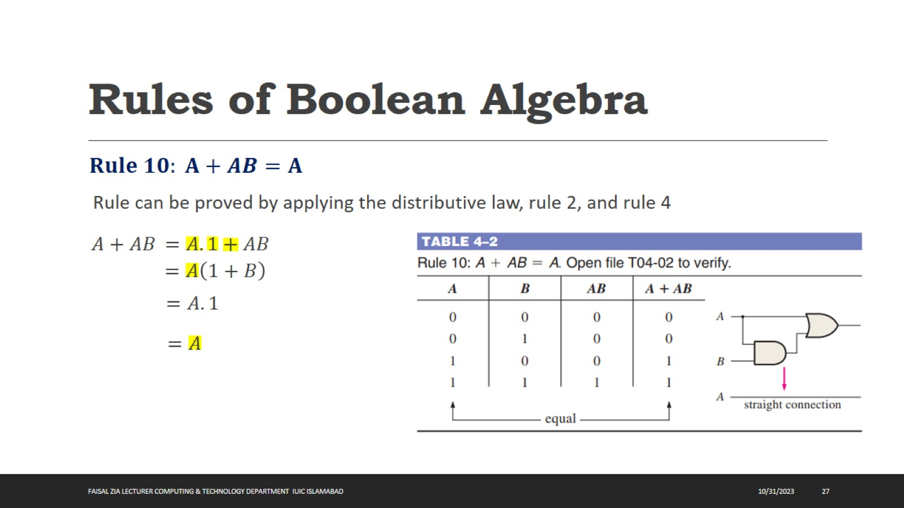
Rules of Boolean Algebra

Slide 28
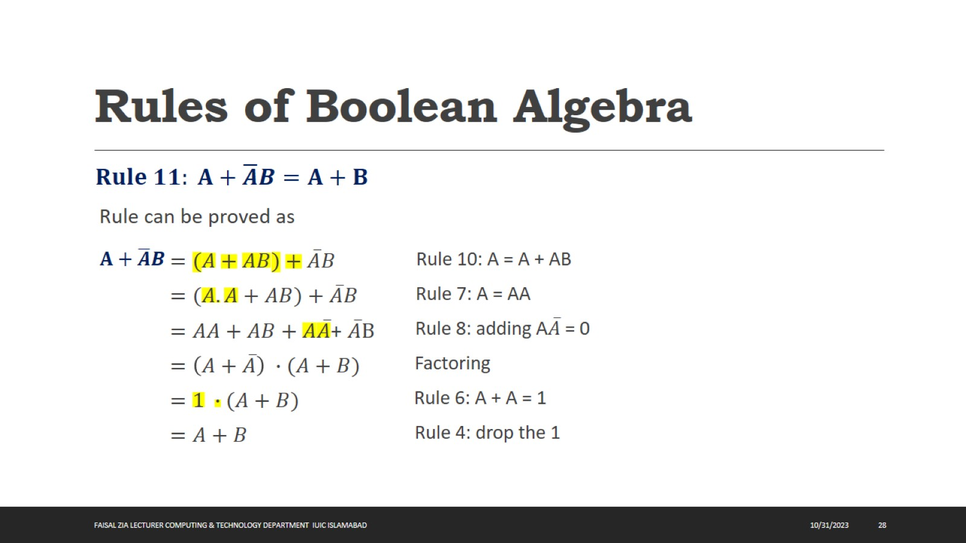
Rules of Boolean Algebra

Slide 29
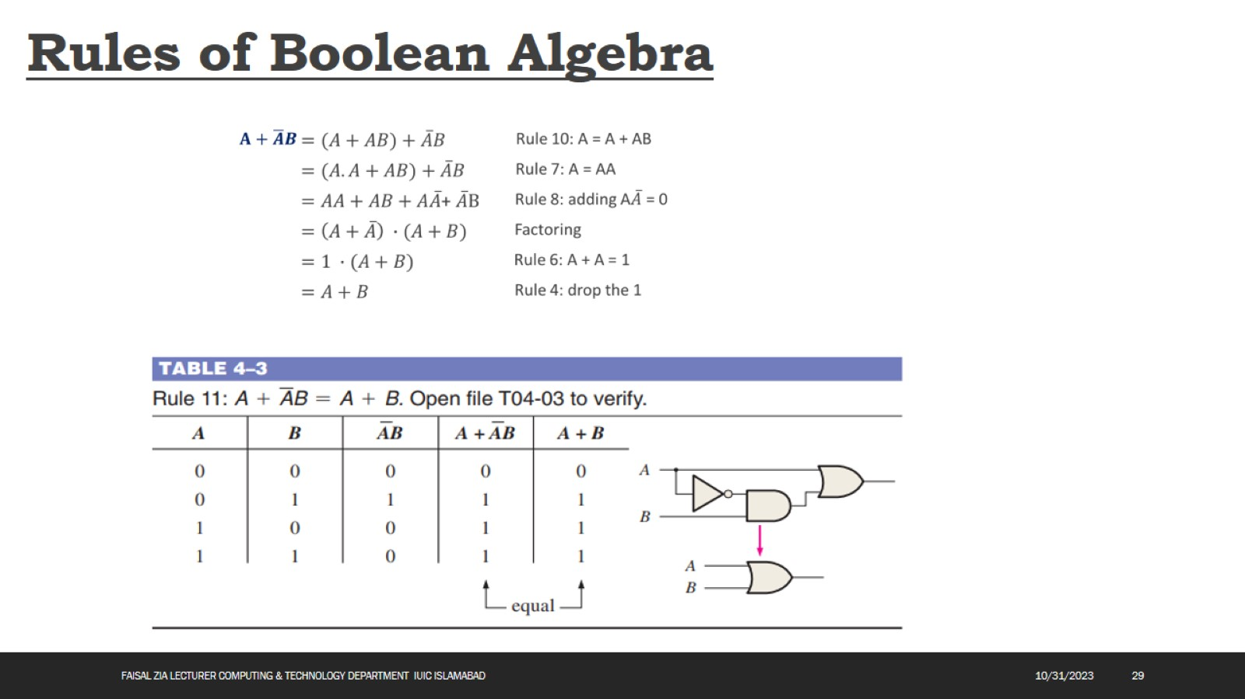
Rules of Boolean Algebra

Slide 30
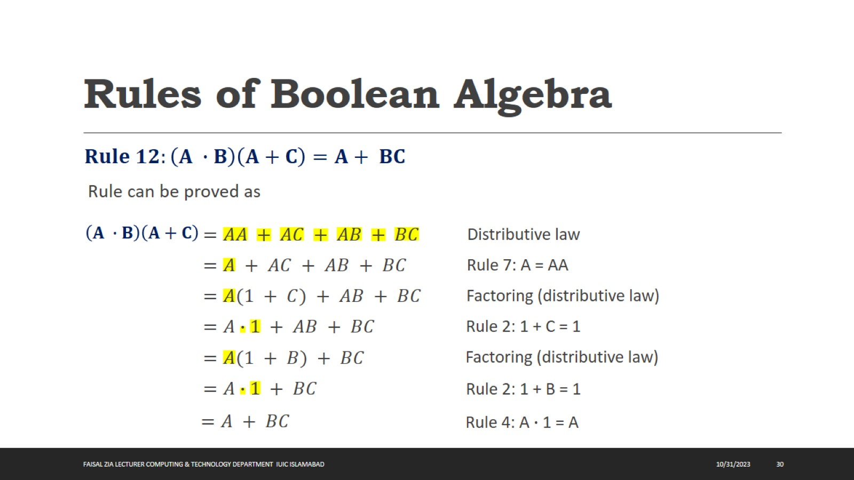
Rules of Boolean Algebra

Slide 31
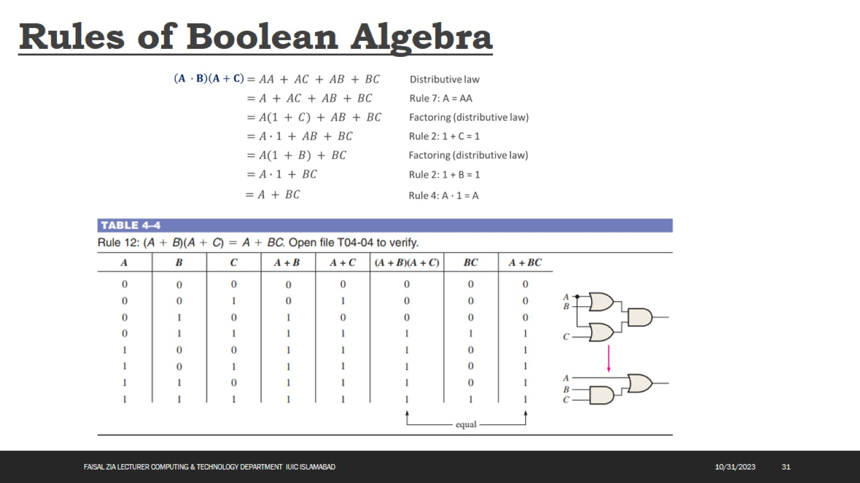
Rules of Boolean Algebra

Slide 32
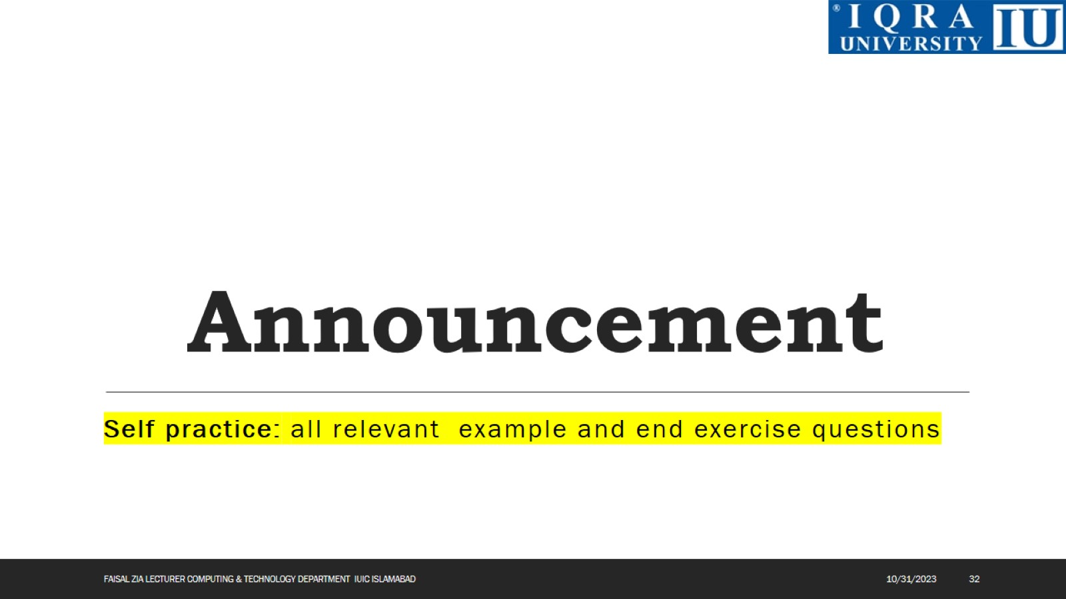
Announcement

Slide 33
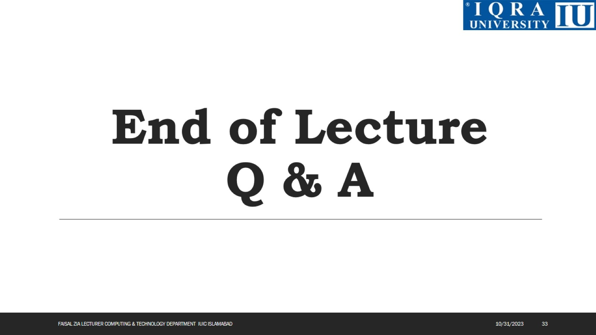
End of Lecture Q & A

